Slide 1
Šabloni
PATTERNS

Slide 2
Background
Pattern Overview:
  Analysis Patterns: Recurring & reusable analysis models
  Design Patterns: Solution skeletons for software design, often object oriented
  Organizational Patterns: Structure of organizations/ projects
  Process Patterns: Software process design
  Security Patterns: Skeletons to provide system security
  Requirements Patterns
  Many more existing, Patterns can be found in almost any domain
www.cse.msu.edu/sens/sensTalks/Sp2003/docs/2003-02...

Slide 3

Pattern Essentials
A pattern has 4 essential elements:
Pattern name
Problem
Solution
Consequences
PROBLEM
NAME
SOLUTION
CONSE-
QUENCES
www.cse.msu.edu/sens/sensTalks/Sp2003/docs/2003-02...

Slide 4
Requirements Patterns Template
Design Patterns
Template [Gamma]:
Idea:
Use similar approach
More concrete than analysis patterns
More abstract than design patterns
Pattern Name and Classification
Intent
Also Known As
Motivation
Applicability
Structure
Participants
Collaborations
Consequences
Implementation
Sample Code
Known Uses
Related Patterns
www.cse.msu.edu/sens/sensTalks/Sp2003/docs/2003-02...

Slide 5
Requirements Patterns Template
Pattern Name and Classification
Intent
Also Known As
Motivation
Applicability
Structure
Participants
Collaborations
Consequences
Implementation
Sample Code
Known Uses
Related Patterns
Pattern Name and Classification
Intent
Motivation (incl. use cases)
Constraints
Applicability
Structure (class diagram)
Behavior (sequence, state)
Participants
Collaborations
Consequences
Design Patterns
Also Known As
Related Patterns
www.cse.msu.edu/sens/sensTalks/Sp2003/docs/2003-02...
Notes:
Focus on constraints:
For this workshop purposes
Specification patterns for concurrent properties (e.g., safety, deadlocks)
Emphasis on Embedded Systems

Slide 6
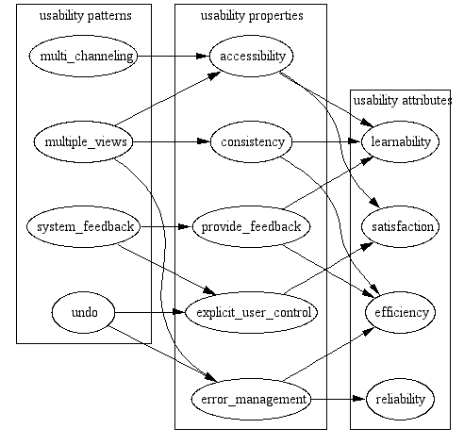
Relationships in the SAU framework
http://www.win.tue.nl/ipa/activities/springdays2005/Folmer.ppt#304,15,Relationships in the SAU framework
Notes:
Positive relationships have been defined between the elements of the framework that link architecture sensitive usability patterns to usability properties and attributes. The framework can be used in two ways:
To Inform design: The usability properties in the framework may be used as requirements during design. For example, if the requirements specify, "the system must provide feedback”, we use the framework to identify which usability patterns may be implemented to fulfill these properties by following the arrows in Figure 1.
Assessment: The framework can also be used to identify the support for usability provided by the architecture sensitive usability patterns and properties that can be identified in an architecture
Our assessment technique uses this framework for the analysis.

Slide 7
Data, information, knowledge (1)
Data – decontextualized representation of facts
Knowledge: Systemic representation of a system(s) by natural or/and artificial knowledge holder.
  Natural Knowledge: Dynamic representation and ideas of the world in human brains.
  Tacit knowledge: Knowledge that can be externalized only partly.
  Explicit knowledge: Externalized knowledge
Information: Interpretation of data by particular knowledge holder

Slide 8



Information Logistics
In a given situation
exactly that information that is needed
Right information
Right location
User
Right time
Just in time

Slide 9




Information Logistics – optimized information flow
Right information
Symbolically – mathematically optimization means searching for the global minimum or maximum
Right location
Right time
Right quality

Slide 10
Information logistics applications
applications that
  “know”
    certain content sources (e.g. health databases)
    a user’s information demand (e.g. from an electronic patient card)
    the user’s location (e.g. at the clinic, at home)
  provide user the information she or he needs (e.g. allergic information, pharmacy services).
  deal with
    Content management
    time management
    communication management
  combine supply modes
    information pool (i.e. the user queries for information)
    information push (by the system).
  are individually customized towards a dedicated user.
An intelligent way of information display and user communication supports the usability of information logistical applications

Slide 11
Information logistics systems ≠ logistics information systems
Information logistics ≠ logistics information

Slide 12
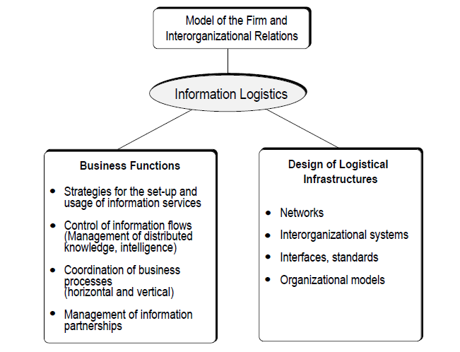
Information logistics impact on logistics in general (1)
http://www.electronicmarkets.org/issues/volume-3/volume-3-issue-3/v3n3_klein0.pdf

Slide 13
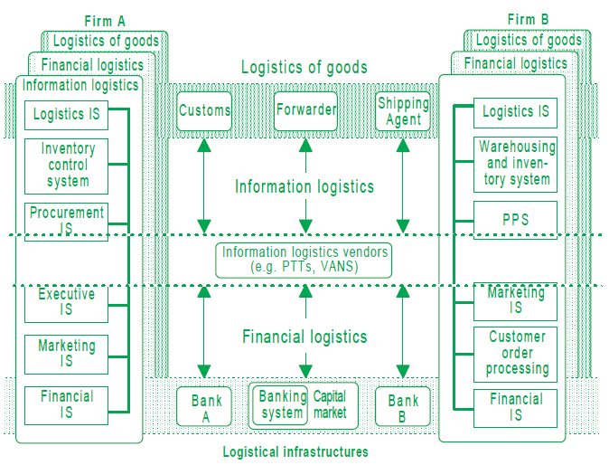
Information logistics and logistics (2)
http://www.electronicmarkets.org/issues/volume-3/volume-3-issue-3/v3n3_klein0.pdf

Slide 14
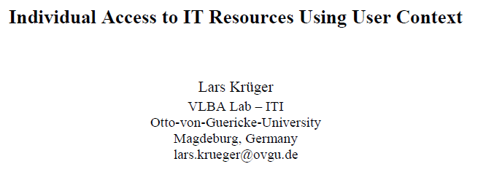
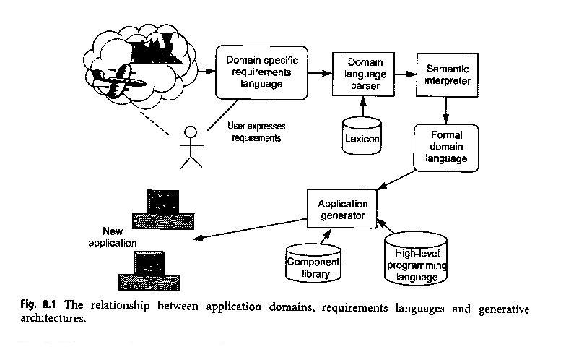
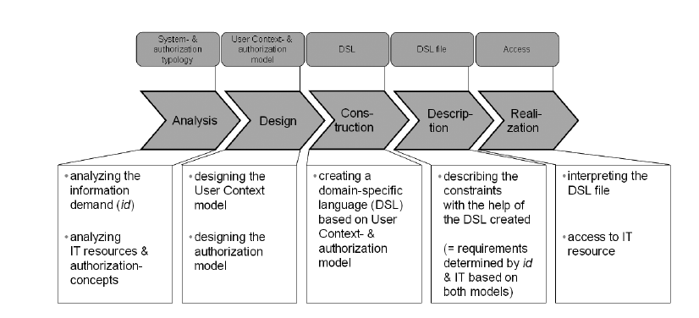
978-0-7695-3776-4/09 $26.00 © 2009 IEEE
DOI 10.1109/CENTRIC.2009.15
A. Sutcliffe

Slide 15
978-0-7695-3776-4/09 $26.00 © 2009 IEEE
DOI 10.1109/CENTRIC.2009.15
A. Sutcliffe

Slide 16
978-0-7695-3776-4/09 $26.00 © 2009 IEEE
DOI 10.1109/CENTRIC.2009.15
A. Sutcliffe

Slide 17
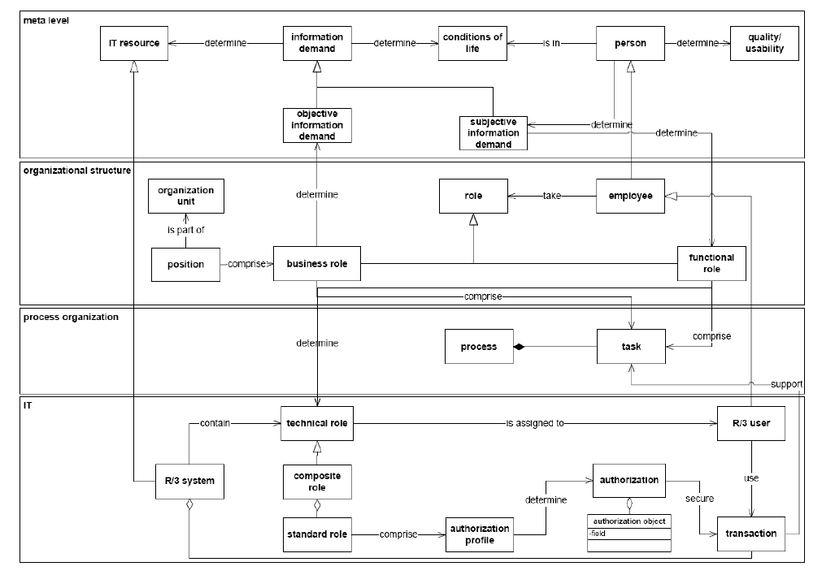
User context model (Kruger)
978-0-7695-3776-4/09 $26.00 © 2009 IEEE
DOI 10.1109/CENTRIC.2009.15

Slide 18
...description of the diagram
User Context. The user’s information demand, i.e. his need for IT resources, arises out of his task and can be classified into objective and subjective information demand. Source for objective information demand is the task description according to his job characteristics described in a business role. The set of IT resources a user needs for the accomplishment of his task (process role) that is carried out in his position (business role) is called IT-role. Subjective information demand contains requests for IT resources that extend the user’s job description and thus leads to a functional role. The discrepancy between objective and subjective information demand is called a special situation within the user life cycle (=conditions of life). All things considered, User Context represents objectively as well as subjectively required IT resources for all tasks that arise from a user's specific situation and it is represented in business as well as functional roles. These roles have to be synchronized with the set of all needed IT resources that are represented in IT roles.
978-0-7695-3776-4/09 $26.00 © 2009 IEEE
DOI 10.1109/CENTRIC.2009.15

Slide 19
Supporting Collaborative Engineering with Information Supply Patterns by Kurt Sandkuhl (1)
An information supply pattern addresses a recurring information supply problem that arises for specific roles and work situations in an enterprise, and presents a conceptual solution to it.

Slide 20
Supporting Collaborative Engineering with Information Supply Patterns by Kurt Sandkuhl (2): Pattern frame
The name of the pattern, which usually is the name of the role the pattern addresses.
A statement about the organisational context where the pattern is useful. This statement usually identifies the application domain or the specific departments or functions in an organisation forming the context for pattern definition.
Problems of a role that the pattern addresses. The tasks and responsibilities a certain role has are described in order to identify and discuss the challenges and problems, which this role usually faces in the defined organisational context.
The conceptual solution that resolves the problem, which for information supply patterns includes three parts:
  Information demand of the role, which is related to the tasks and responsibilities, is described as part of the pattern, i.e. the different parts of the information demand are identified.
  Quality criteria for the different parts of the information demand include the general importance of the information demand part, the importance of receiving the part completely and with high accuracy, and the importance of timely or real-time information supply.
  Timeline indicating the points in time when the different information parts should be available at the latest.

Slide 21
Supporting Collaborative Engineering with Information Supply Patterns by Kurt Sandkuhl (2): Pattern frame continued
The effects that play in forming a solution. If the needed information part should not be available or arrive too late this might affect the possibility of the role to complete its task and responsibilities. The effects described in the pattern include
  Potential economic consequences
  Time/efficiency effects, i.e. whether the role will need more time for completing the task or will be less efficient
  Effects on increasing or reducing the quality of the work results
  Effects on the motivation of the role responsible
  Learning and experience effects
  Effects from a customer perspective
The supply action and information sources for information:
  Supply actions for getting/providing the information show for each information demand what action is required to supply the information to the role under consideration.
  Typical information sources can potentially be IT related sources, organizational sources or other sources. The sources that most likely provide the relevant information are identified in the pattern description.
  Relations to organizational information model: in case the information is available within the own organisation it is essential to know in which internal information sources information usually can be found.
  Organizational sources for information can be organization structure related, i.e. other roles or organization units, or work process related, i.e. activities or work processes.

Slide 22
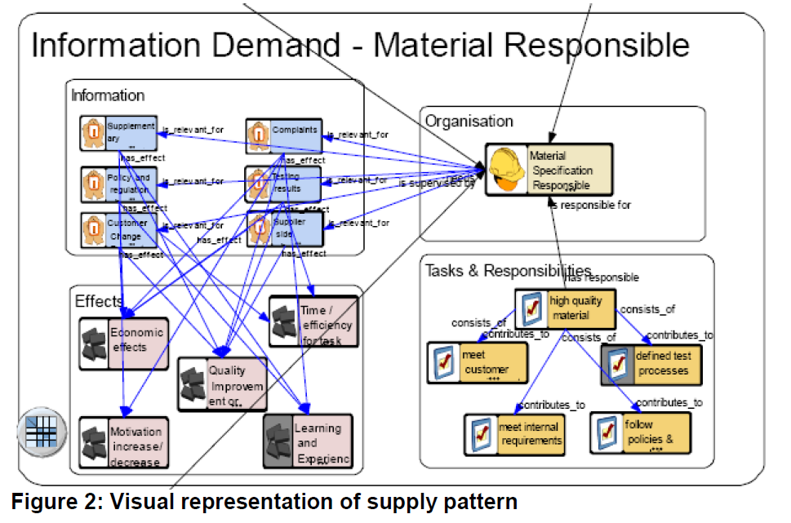
....

Slide 23
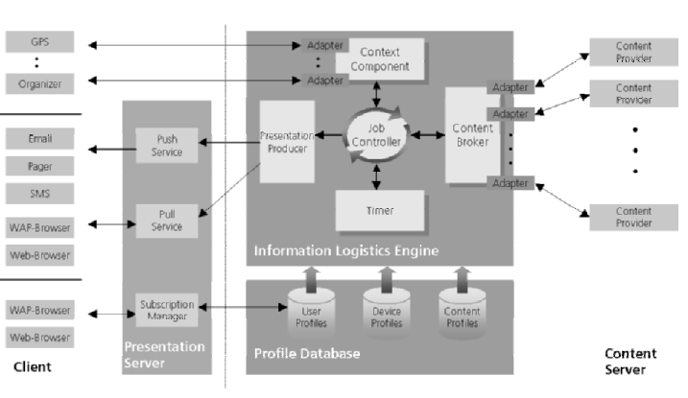
WIND- Weather Information on-
Demand (2003)
From papers by K. Sandkuhl

Slide 24
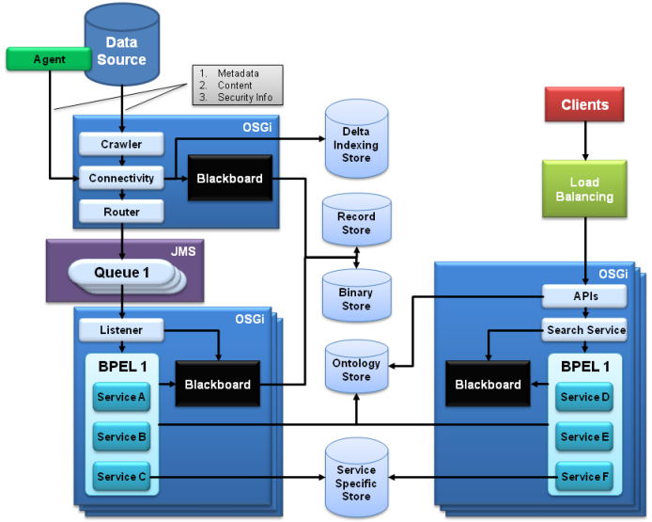
SMILA
SMILA is an extensible framework for building search solutions to access unstructured information in the enterprise. Besides providing essential infrastructure components and services, SMILA also delivers ready-to-use add-on components, like connectors to most relevant data sources. Using the framework as their basis will enable developers to concentrate on the creation of higher value solutions, like semantic driven applications etc.
http://www.eclipse.org/smila/

Slide 25
Additional readings
http://www.colorado.edu/geography/gcraft/notes/ethics/ethics_f.html

Slide 26
SOCIO-CULTURAL ASPECTS
IT PROFESSIONAL ASPECTS
BUSINESS ASPECTS
Ethics in information systems development

Slide 27
Software Engineering Code of Ethics and Professional Practice http://www.acm.org/about/se-code#short
Eight Principles
1. PUBLIC - Software engineers shall act consistently with the public interest.
2. CLIENT AND EMPLOYER - Software engineers shall act in a manner that is in the best interests of their client and employer consistent with the public interest.
3. PRODUCT - Software engineers shall ensure that their products and related modifications meet the highest professional standards possible.
4. JUDGMENT - Software engineers shall maintain integrity and independence in their professional judgment.
5. MANAGEMENT - Software engineering managers and leaders shall subscribe to and promote an ethical approach to the management of software development and maintenance.
6. PROFESSION - Software engineers shall advance the integrity and reputation of the profession consistent with the public interest.
7. COLLEAGUES - Software engineers shall be fair to and supportive of their colleagues.
8. SELF - Software engineers shall participate in lifelong learning regarding the practice of their profession and shall promote an ethical approach to the practice of the profession.

Slide 28
PUBLIC
1.01. Accept full responsibility for their own work.
1.02. Moderate the interests of the software engineer, the employer, the client and the users with the public good.
1.03. Approve software only if they have a well-founded belief that it is safe, meets specifications, passes appropriate tests, and does not diminish quality of life, diminish privacy or harm the environment. The ultimate effect of the work should be to the public good.
1.04. Disclose to appropriate persons or authorities any actual or potential danger to the user, the public, or the environment, that they reasonably believe to be associated with software or related documents.
1.05. Cooperate in efforts to address matters of grave public concern caused by software, its installation, maintenance, support or documentation.
1.06. Be fair and avoid deception in all statements, particularly public ones, concerning software or related documents, methods and tools.
1.07. Consider issues of physical disabilities, allocation of resources, economic disadvantage and other factors that can diminish access to the benefits of software.
1.08. Be encouraged to volunteer professional skills to good causes and contribute to public education concerning the discipline.

Slide 29
CLIENT AND EMPLOYER
2.01. Provide service in their areas of competence, being honest and forthright about any limitations of their experience and education.
2.02. Not knowingly use software that is obtained or retained either illegally or unethically.
2.03. Use the property of a client or employer only in ways properly authorized, and with the client's or employer's knowledge and consent.
2.04. Ensure that any document upon which they rely has been approved, when required, by someone authorized to approve it.
2.05. Keep private any confidential information gained in their professional work, where such confidentiality is consistent with the public interest and consistent with the law.
2.06. Identify, document, collect evidence and report to the client or the employer promptly if, in their opinion, a project is likely to fail, to prove too expensive, to violate intellectual property law, or otherwise to be problematic.
2.07. Identify, document, and report significant issues of social concern, of which they are aware, in software or related documents, to the employer or the client.
2.08. Accept no outside work detrimental to the work they perform for their primary employer.
2.09. Promote no interest adverse to their employer or client, unless a higher ethical concern is being compromised; in that case, inform the employer or another appropriate authority of the ethical concern.

Slide 30
PRODUCT (1)
3.01. Strive for high quality, acceptable cost and a reasonable schedule, ensuring significant tradeoffs are clear to and accepted by the employer and the client, and are available for consideration by the user and the public.
3.02. Ensure proper and achievable goals and objectives for any project on which they work or propose.
3.03. Identify, define and address ethical, economic, cultural, legal and environmental issues related to work projects.
3.04. Ensure that they are qualified for any project on which they work or propose to work by an appropriate combination of education and training, and experience.
3.05. Ensure an appropriate method is used for any project on which they work or propose to work.
3.06. Work to follow professional standards, when available, that are most appropriate for the task at hand, departing from these only when ethically or technically justified.
3.07. Strive to fully understand the specifications for software on which they work.
3.08. Ensure that specifications for software on which they work have been well documented, satisfy the users’ requirements and have the appropriate approvals.

Slide 31
PRODUCT (2)
3.09. Ensure realistic quantitative estimates of cost, scheduling, personnel, quality and outcomes on any project on which they work or propose to work and provide an uncertainty assessment of these estimates.
3.10. Ensure adequate testing, debugging, and review of software and related documents on which they work.
3.11. Ensure adequate documentation, including significant problems discovered and solutions adopted, for any project on which they work.
3.12. Work to develop software and related documents that respect the privacy of those who will be affected by that software.
3.13. Be careful to use only accurate data derived by ethical and lawful means, and use it only in ways properly authorized.
3.14. Maintain the integrity of data, being sensitive to outdated or flawed occurrences.
3.15 Treat all forms of software maintenance with the same professionalism as new development.

Slide 32
JUDGMENT
4.01. Temper all technical judgments by the need to support and maintain human values.
4.02 Only endorse documents either prepared under their supervision or within their areas of competence and with which they are in agreement.
4.03. Maintain professional objectivity with respect to any software or related documents they are asked to evaluate.
4.04. Not engage in deceptive financial practices such as bribery, double billing, or other improper financial practices.
4.05. Disclose to all concerned parties those conflicts of interest that cannot reasonably be avoided or escaped.
4.06. Refuse to participate, as members or advisors, in a private, governmental or professional body concerned with software related issues, in which they, their employers or their clients have undisclosed potential conflicts of interest.

Slide 33
MANAGEMENT
5.01 Ensure good management for any project on which they work, including effective procedures for promotion of quality and reduction of risk.
5.02. Ensure that software engineers are informed of standards before being held to them.
5.03. Ensure that software engineers know the employer's policies and procedures for protecting passwords, files and information that is confidential to the employer or confidential to others.
5.04. Assign work only after taking into account appropriate contributions of education and experience tempered with a desire to further that education and experience.
5.05. Ensure realistic quantitative estimates of cost, scheduling, personnel, quality and outcomes on any project on which they work or propose to work, and provide an uncertainty assessment of these estimates.
5.06. Attract potential software engineers only by full and accurate description of the conditions of employment.
5.07. Offer fair and just remuneration.
5.08. Not unjustly prevent someone from taking a position for which that person is suitably qualified.
5.09. Ensure that there is a fair agreement concerning ownership of any software, processes, research, writing, or other intellectual property to which a software engineer has contributed.
5.10. Provide for due process in hearing charges of violation of an employer's policy or of this Code.
5.11. Not ask a software engineer to do anything inconsistent with this Code.
5.12. Not punish anyone for expressing ethical concerns about a project.

Slide 34
PROFESSION
6.01. Help develop an organizational environment favorable to acting ethically.
6.02. Promote public knowledge of software engineering.
6.03. Extend software engineering knowledge by appropriate participation in professional organizations, meetings and publications.
6.04. Support, as members of a profession, other software engineers striving to follow this Code.
6.05. Not promote their own interest at the expense of the profession, client or employer.
6.06. Obey all laws governing their work, unless, in exceptional circumstances, such compliance is inconsistent with the public interest.
6.07. Be accurate in stating the characteristics of software on which they work, avoiding not only false claims but also claims that might reasonably be supposed to be speculative, vacuous, deceptive, misleading, or doubtful.
6.08. Take responsibility for detecting, correcting, and reporting errors in software and associated documents on which they work.
6.09. Ensure that clients, employers, and supervisors know of the software engineer's commitment to this Code of ethics, and the subsequent ramifications of such commitment.
6.10. Avoid associations with businesses and organizations which are in conflict with this code.
6.11. Recognize that violations of this Code are inconsistent with being a professional software engineer.
6.12. Express concerns to the people involved when significant violations of this Code are detected unless this is impossible, counter-productive, or dangerous.
6.13. Report significant violations of this Code to appropriate authorities when it is clear that consultation with people involved in these significant violations is impossible, counter-productive or dangerous.

Slide 35
COLLEAGUES
7.01. Encourage colleagues to adhere to this Code.
7.02. Assist colleagues in professional development.
7.03. Credit fully the work of others and refrain from taking undue credit.
7.04. Review the work of others in an objective, candid, and properly-documented way.
7.05. Give a fair hearing to the opinions, concerns, or complaints of a colleague.
7.06. Assist colleagues in being fully aware of current standard work practices including policies and procedures for protecting passwords, files and other confidential information, and security measures in general.
7.07. Not unfairly intervene in the career of any colleague; however, concern for the employer, the client or public interest may compel software engineers, in good faith, to question the competence of a colleague.
7.08. In situations outside of their own areas of competence, call upon the opinions of other professionals who have competence in that area.

Slide 36
SELF
8.01. Further their knowledge of developments in the analysis, specification, design, development, maintenance and testing of software and related documents, together with the management of the development process.
8.02. Improve their ability to create safe, reliable, and useful quality software at reasonable cost and within a reasonable time.
8.03. Improve their ability to produce accurate, informative, and well-written documentation.
8.04. Improve their understanding of the software and related documents on which they work and of the environment in which they will be used.
8.05. Improve their knowledge of relevant standards and the law governing the software and related documents on which they work.
8.06 Improve their knowledge of this Code, its interpretation, and its application to their work.
8.07 Not give unfair treatment to anyone because of any irrelevant prejudices.
8.08. Not influence others to undertake any action that involves a breach of this Code.
8.09. Recognize that personal violations of this Code are inconsistent with being a professional software engineer.

Slide 37
7 Principles of Admirable Business Ethics Business Ethics for Small Business
From Robert Moment
1. Be Trustful: Recognize customers want to do business with a company they can trust; when trust is at the core of a company, it's easy to recognize. Trust defined, is assured reliance on the character, ability, strength, and truth of a business.
2. Keep An Open Mind: For continuous improvement of a company, the leader of an organization must be open to new ideas. Ask for opinions and feedback from both customers and team members and your company will continue to grow.
3. Meet Obligations: Regardless of the circumstances, do everything in your power to gain the trust of past customer's and clients, particularly if something has gone awry. Reclaim any lost business by honoring all commitments and obligations.
4. Have Clear Documents: Re-evaluate all print materials including small business advertising, brochures, and other business documents making sure they are clear, precise and professional. Most important, make sure they do not misrepresent or misinterpret.
5. Become Community Involved: Remain involved in community-related issues and activities, thereby demonstrating that your business is a responsible community contributor. In other words, stay involved.
6. Maintain Accounting Control: Take a hands-on approach to accounting and record keeping, not only as a means of gaining a better feel for the progress of your company, but as a resource for any "questionable " activities. Gaining control of accounting and record keeping allows you to end any dubious activities promptly.
7. Be Respectful: Treat others with the utmost of respect. Regardless of differences, positions, titles, ages, or other types of distinctions, always treat others with professional respect and courtesy.

Slide 38
Additional reading
ACM - http://www.umsl.edu/~sauterv/analysis/ACMcode.pdf
http://www.globalethics.org/
http://www.business-ethics.org/index.asp

Slide 39
Cognitive issues in information systems development
Based on material from A. Sutcliffe “User Centred Requirements Engineering”, Springer-Verlag, 2002

Slide 40
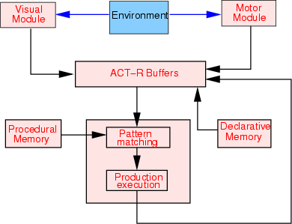
Model of huma cognition (1) http://www.fizyka.umk.pl/~duch/ref/03/03-Brain-like/ACT-R-buffers.gif
Model of human cognition (1)

Slide 41
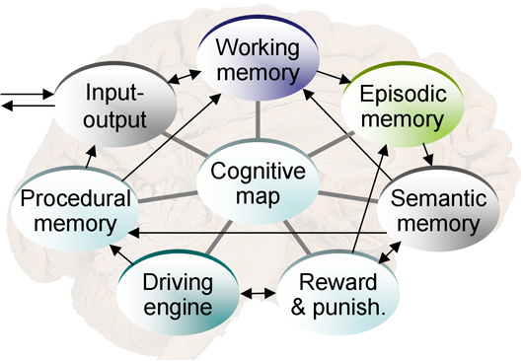
Model of human cognition (2)
http://cs.gmu.edu/~eclab/images/birdview.jpg

Slide 42
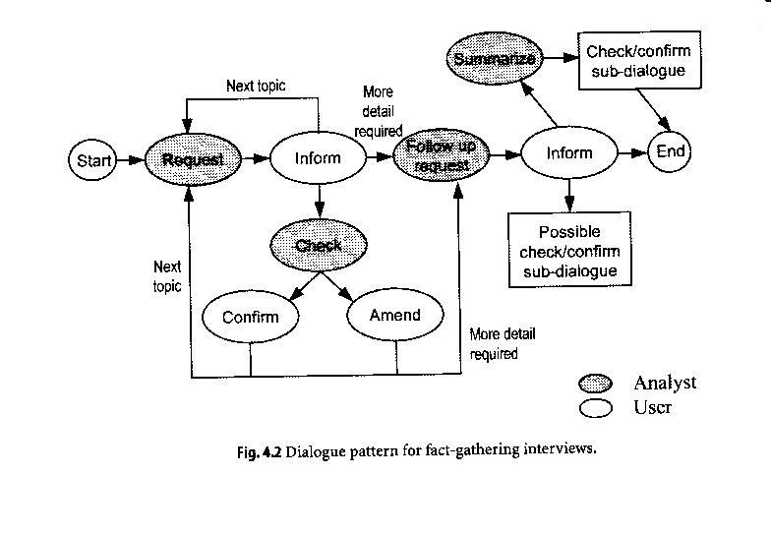
Material from A. Sutcliffe “User Centred Requirements Engineering”, Springer-Verlag, 2002

Slide 43
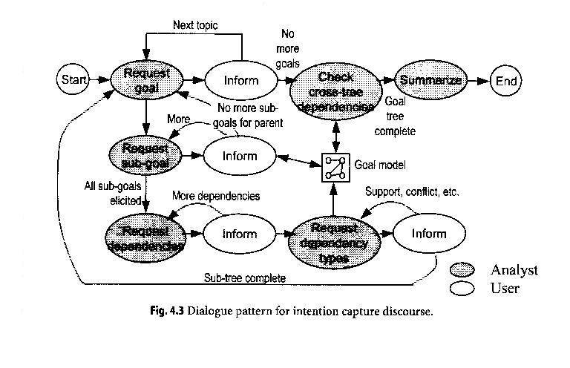
Material from A. Sutcliffe “User Centred Requirements Engineering”, Springer-Verlag, 2002

Slide 44
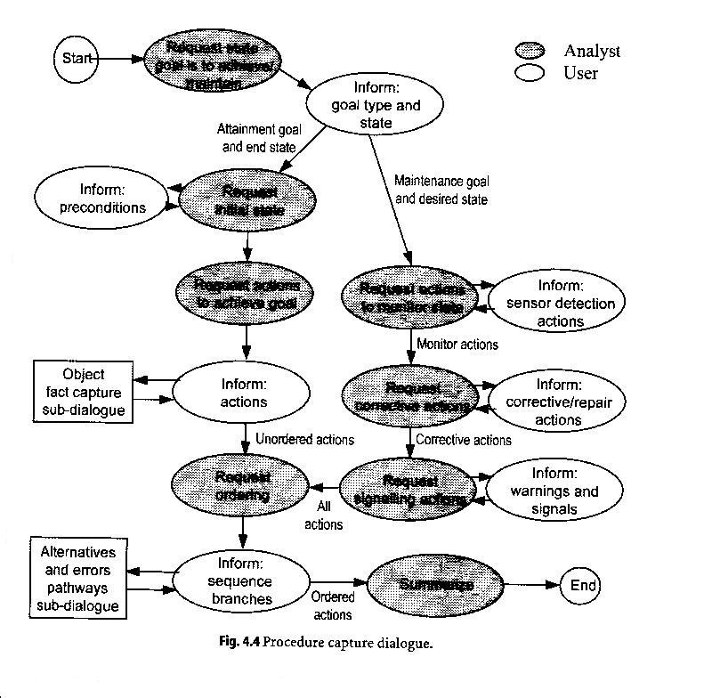
Material from A. Sutcliffe “User Centred Requirements Engineering”, Springer-Verlag, 2002

Slide 45
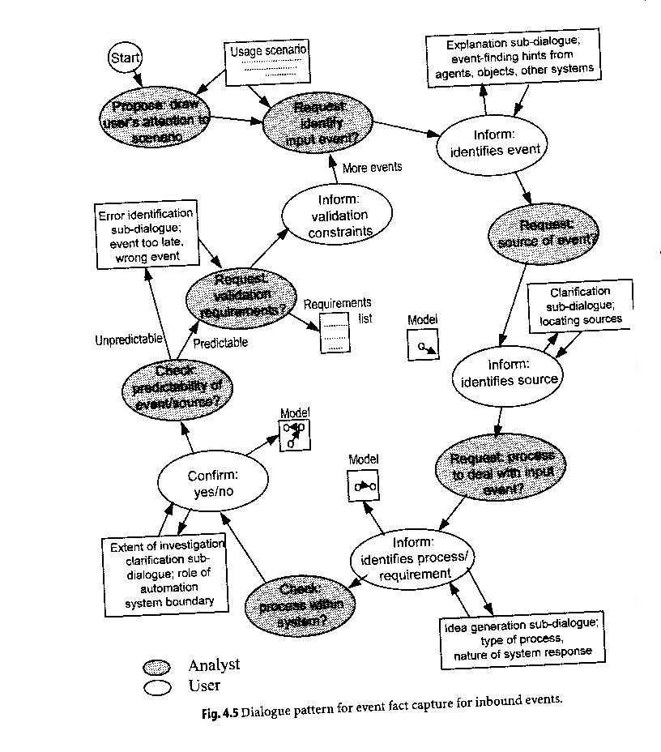
Material from A. Sutcliffe “User Centred Requirements Engineering”, Springer-Verlag, 2002

Slide 46
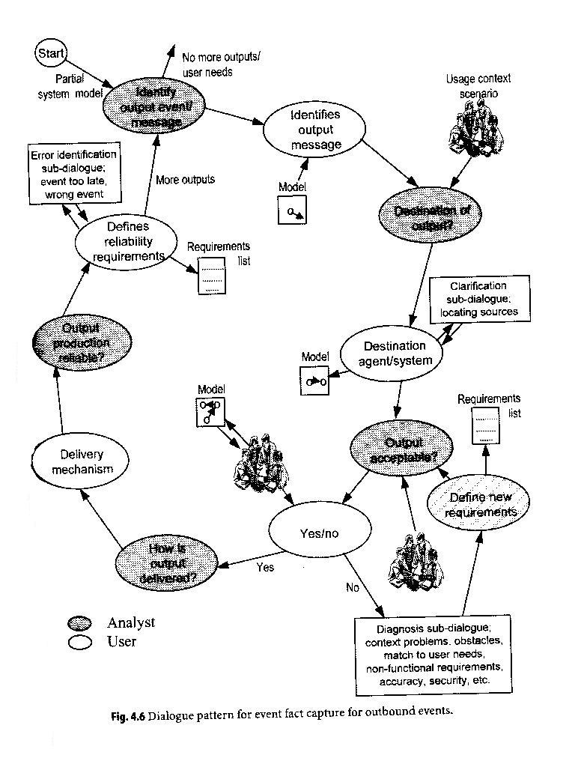
Material from A. Sutcliffe “User Centred Requirements Engineering”, Springer-Verlag, 2002

Slide 47
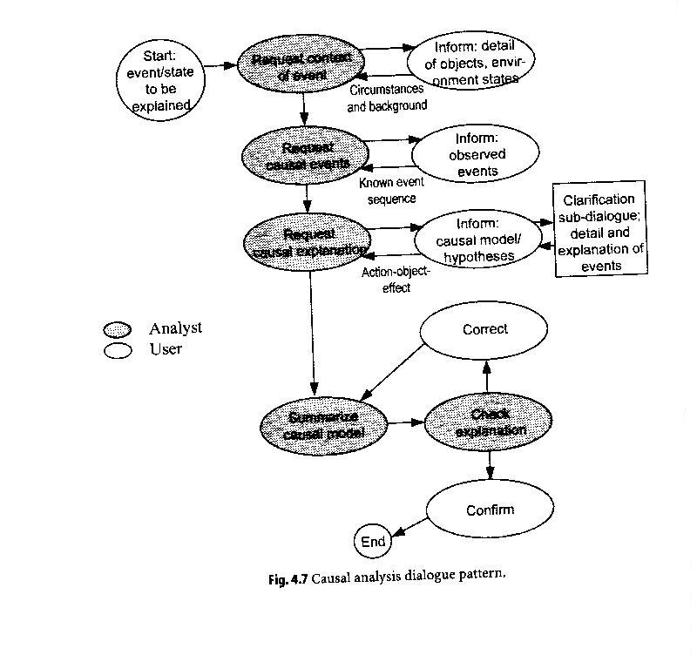
Material from A. Sutcliffe “User Centred Requirements Engineering”, Springer-Verlag, 2002

Slide 48
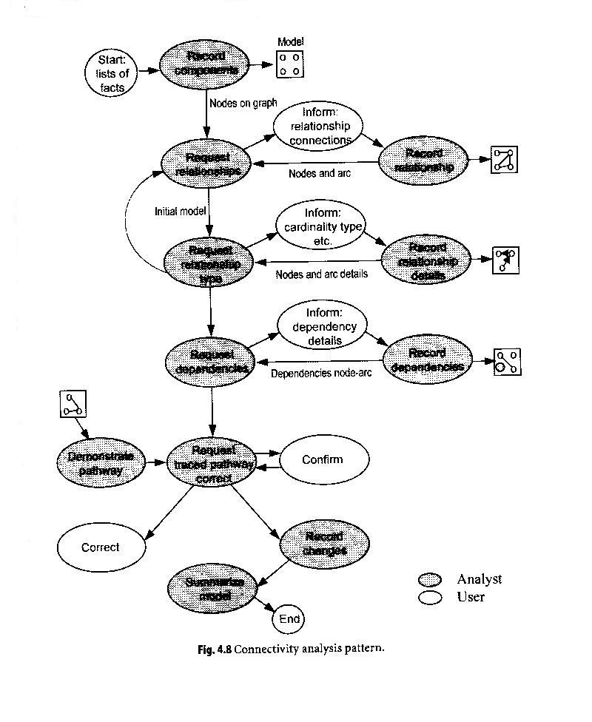
Material from A. Sutcliffe “User Centred Requirements Engineering”, Springer-Verlag, 2002

Slide 49
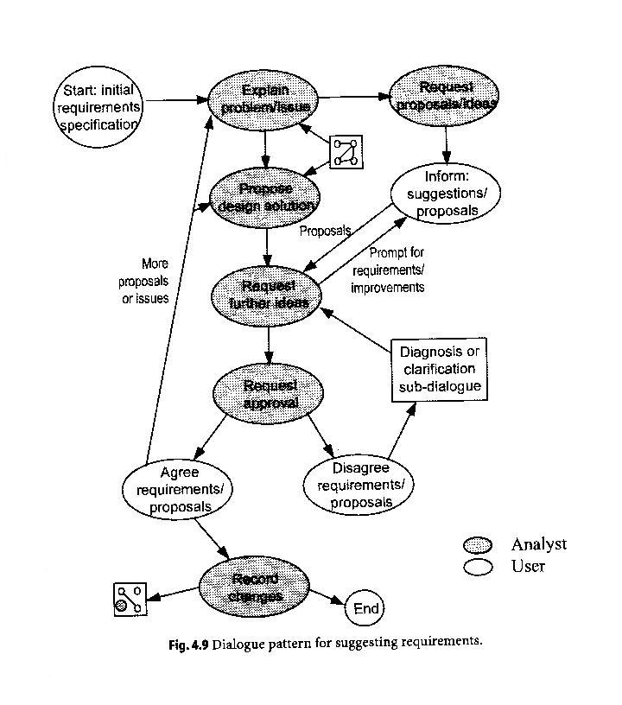
Material from A. Sutcliffe “User Centred Requirements Engineering”, Springer-Verlag, 2002

Slide 50
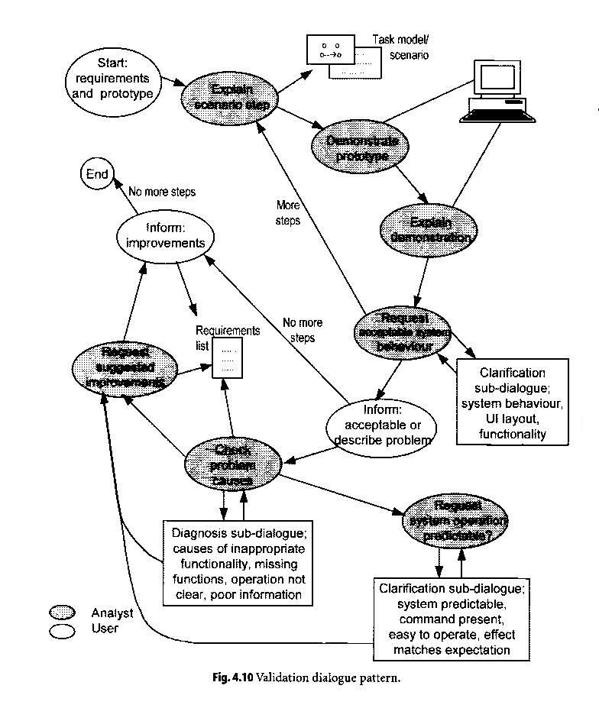

Slide 51
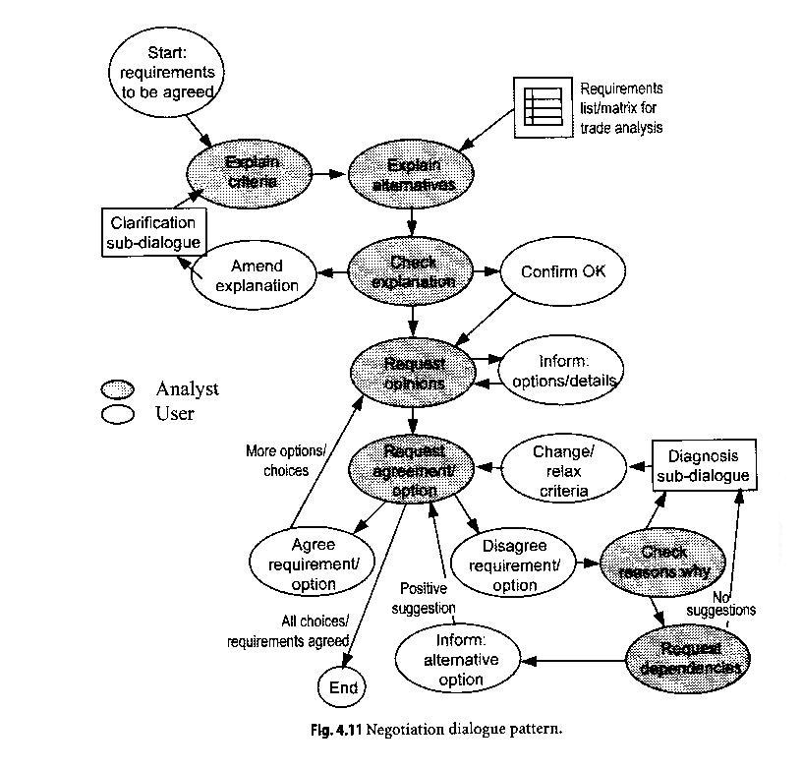
Material from A. Sutcliffe “User Centred Requirements Engineering”, Springer-Verlag, 2002

Slide 52
Vietas
http://rep04.desy.de/ - konferences
http://repare.desy.de/Repare/RepareController?controller=0&action=4
Demo
http://www.softwareprojects.org/software-requirement-management-01.htm
Demo
http://www.esi.nl/site/knowledge/sasg/Offerman%20Applied%20SWA%20Patterns.pdf
Demo

